Slide 1
Firmware Design for a 4-Floor Elevator Controller
Final Project Presentation
Department of Electrical and Computer Engineering
January 10, 2025

Slide 2







Table of Contents
1
Introduction
2
System Features
3
Firmware Architecture
4
Challenges
5
Future Work
6
Conclusion
7
References

Slide 3
Introduction
Introduction
Overview of the project: 4-floor elevator controller. Key objectives:
Ensure operational efficiency and passenger safety. Develop modular firmware architecture.
Achieve scalability for additional floors or features.
Focus on compliance with industry standards for automation and safety.

Slide 4
System Features
System Features
Floor-level controls:
Floor buttons and indicators (7-segment display). Directional LEDs for UP/DOWN movement.
Cabin features:
Real-time time, date, and temperature display. I2C-based RTC and LM35 sensor integration.
Motor control:
Dual-speed system for smooth acceleration and deceleration. Limit switches for precise cabin positioning.

Slide 5
Firmware Architecture
Block Diagram
Floor Buttons
Elevator Controller
Motor and Indicators

Slide 6
Firmware Design
Firmware Architecture
Modular design for scalability and maintainability. Cooperative scheduler for efficient task management:
Motor control. Display updates.
Button input handling.
Optimized codebase for easy debugging and future upgrades.

Slide 7
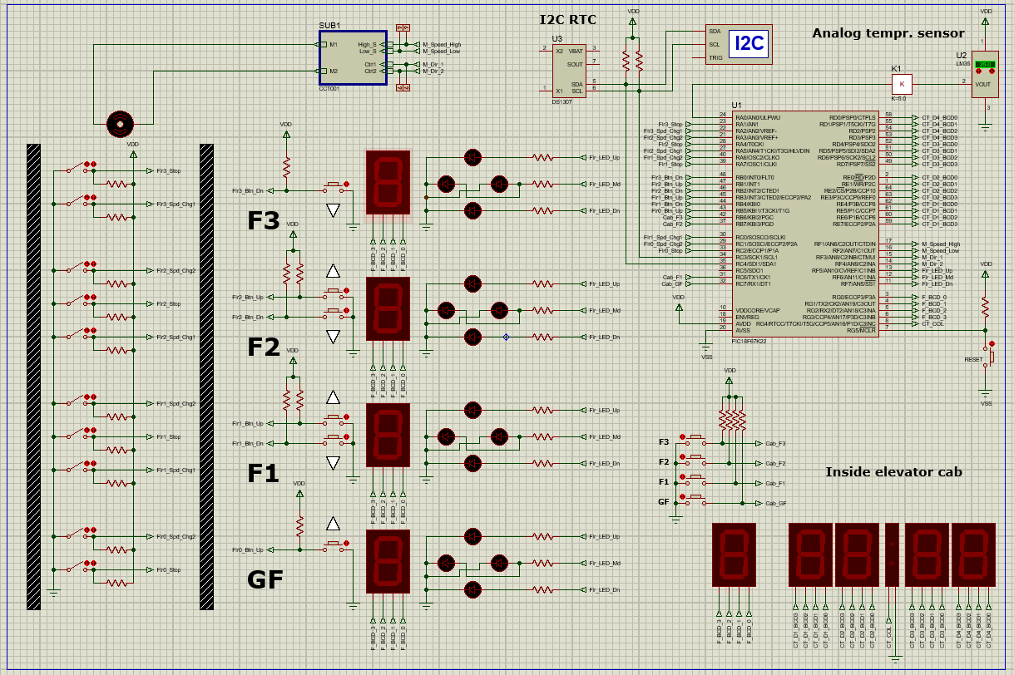
Architecture Breakdown

Slide 8
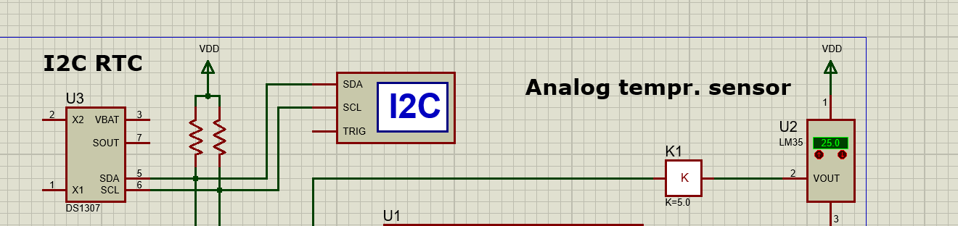
The Sensors

Slide 9
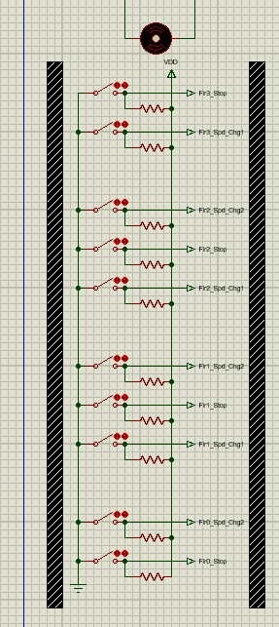
The Floor Functions
Speed Change UP (Spd_Chg1): When the elevator is moving upward, the speed changes to Low Speed before reaching the next floor.
Speed Change DOWN (Spd_Chg2): When moving downward, the speed changes to Low Speed before stopping at the floor below. When traveling at high speed between floors the bin for M_Speed_High . When a speed change sensor is tirggerd the one or the two the system slows down by turning on M_Speed_Low pin and disabling the M_Speed_High. And when we reach said floor by going up or down the stop sensor Flr_stop is activated and both speed bins are disabled and the motor is in halt mode

Slide 10
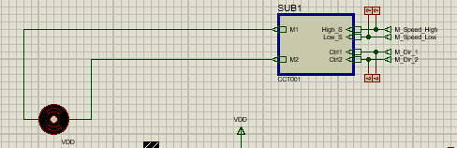
The motor & it’s components
You’ve got the motor which is responsible of the elevator movement which is controlled by the Sub. The Sub has multiple controls like the 2 speeds and the elevator’s direction

Slide 11
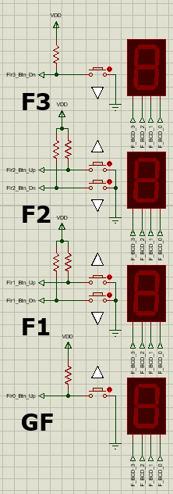
The buttons & displays on Each floor
When a button (FlrX_Btn_Up or FlrX_Btn_Dn) is pressed, it sends a signal to the microcontroller to request the elevator to move in the desired direction. The system activates the motor control logic (M_Speed_High, M_Speed_Low, M_Dir_1, M_Dir_2) to move the elevator. Upon approaching the target floor, the motor slows down and stops at the correct position, and the floor display updates to show the current floor.

Slide 12
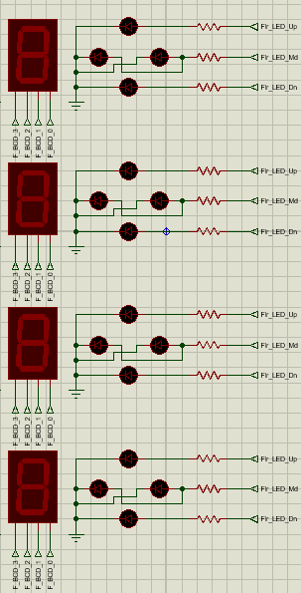
Floor Leds
Flr_LED_Up: Indicates the elevator is moving upward from this floor.
Flr_LED_Dn: Indicates the elevator is moving downward from this floor.
Flr_LED_Md: Possibly indicates the elevator is currently at this floor.

Slide 13
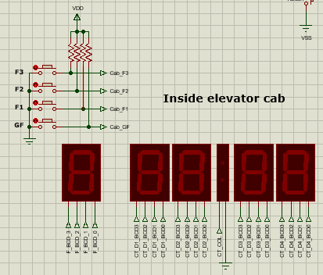
The Elevator Cab Display
You’ve got the buttons of each floor in the cabin of the elevator and for the display’s the nearest to the left is the one used to display the floor we’re currently on and the others are used to display 3 things to be exact the date As in the day of the month 28:12 The 28th of december or the time 12:30 as in 12:30 pm or am and finally the temperature like 25:dc d as in degree and the c for Celsius each one is displayed for 10 seconds before moving to the next and it loops on forever ofc the temperature is read by the LM35 sensor and the date & time using the DS1307 I2 C Real-Time Clock

Slide 14
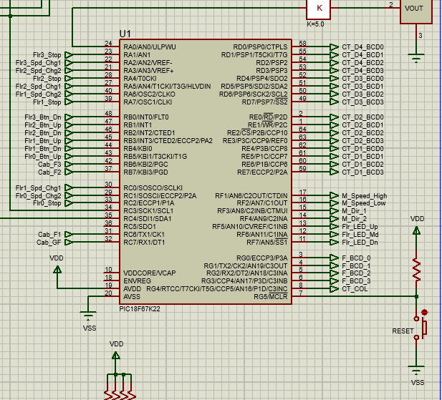
The Microcontroller
Microcontroller (U1: PIC18F67K22):
Central processing unit for the elevator system.
Manages inputs (e.g., floor buttons, speed control) and outputs (e.g., motor control, LEDs, displays).

Slide 15
Flowchart
Firmware Architecture
Start
Yes
Floor Button Pressed? Move Elevator
No
Update Display
Wait
Figure: Flowchart for Elevator System Logic

Slide 16
Challenges
Challenges
Synchronizing tasks for real-time operations.
Calibrating dual-speed motor control using PWM signals. Debugging I2C communication for RTC integration.

Slide 17
Possible Expansions
Future Work
Add touch-screen interface for cabin controls.
Integrate IoT capabilities for remote monitoring and diagnostics. Expand to support more floors and advanced safety features.

Slide 18
Conclusion
Conclusion
Successfully implemented a scalable and reliable elevator controller.
Modular firmware ensures adaptability for future enhancements. Demonstrated the potential of embedded systems in automation.

Slide 19
References
References
Project documentation and industry standards. Datasheets for LM35 and RTC components.
Academic and technical resources on embedded systems.

Slide 20

Thank your for your time

